Slide 1
SILENT-NETWORK Authentication
Resolving Authentication Challenges with Silent Network Authentication and Multi-Factor Authentication (MFA)
Sameena Khan – LEAD UX Researcher & STRATEGIST

Slide 2

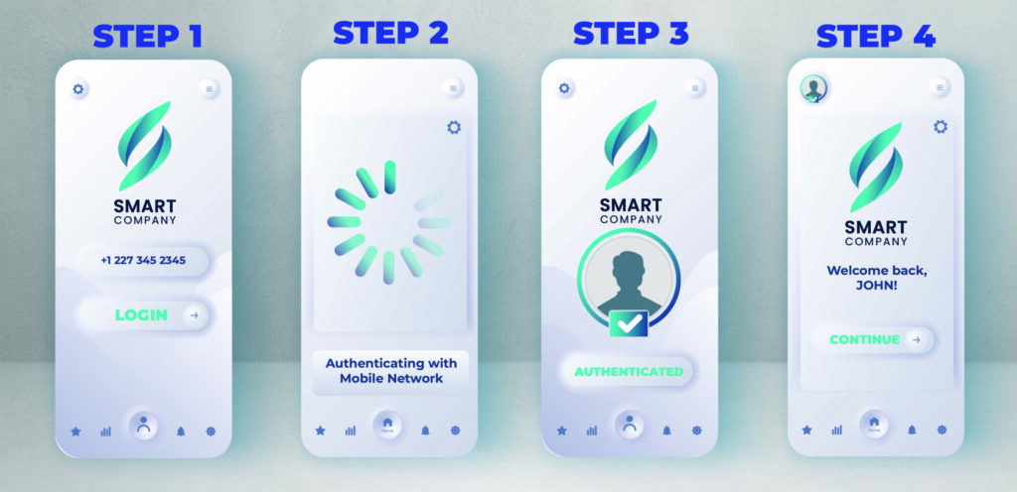
Introduction
In the digital realm, user authentication stands as a critical cornerstone for secure transactions. This case study delves into the amalgamation of silent network authentication and multi-factor authentication (MFA) to address the prevalent challenges posed by traditional login credentials, particularly in the context of bill payments.
Agile Team: Researchers, Designers, Product and Engineering Partners

Slide 3
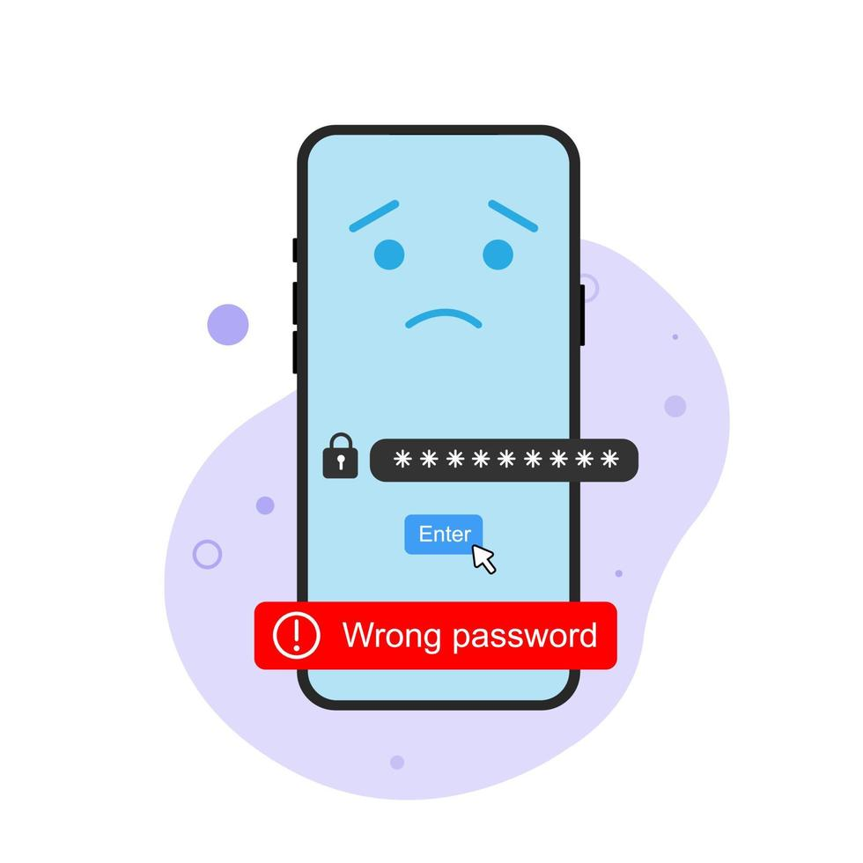
Problem statement
The ubiquity of usernames and passwords (login credentials) has long been associated with various security vulnerabilities, including password theft, phishing attacks, and user inconvenience. Moreover, users often struggle to remember multiple passwords, leading to password fatigue and increased susceptibility to security breaches. These challenges underscore the need for a more robust and user-friendly authentication solution for secure transactions.

Slide 4
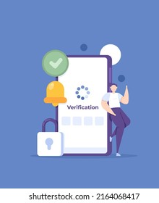
Objective
The primary objective of this project was to alleviate the shortcomings of traditional login credentials by integrating silent network authentication and multi-factor authentication (MFA) for secure transactions, with a specific focus on bill payments. By addressing the inherent limitations of usernames and passwords, our aim was to enhance security and streamline the authentication process, thereby improving the overall user experience.
Silent Network Authentication

Slide 5
RESEARCH Objective & Questions
Understand the tangible and intangible needs, feelings, and behaviors that would indicate what should ideally change to make the authentication process seamless and intuitive.
What tangible and intangible aspects of the current authentication process do users find cumbersome or inconvenient, and what emotions or frustrations do these aspects evoke?
How do users behave when encountering difficulties or challenges during authentication, and what specific features or elements do they find intuitive or confusing?
What are the key pain points hindering seamlessness in the current authentication process, and how do users perceive the trade-off between security and convenience?
How do users' past experiences, cultural backgrounds, and expectations shape their preferences and attitudes towards authentication methods, and how can we measure the success of changes aimed at enhancing seamlessness and intuitiveness
Notes:
Sameena

Slide 6
Research methodology
User interviews: conducted in-depth interviews with 6 participants from diverse backgrounds to explore authentication preferences, security concerns, and transactional behaviors. Explored challenges of traditional login credentials and readiness for alternative authentication methods.
Prototype testing: developed interactive prototypes integrating silent network authentication and multi-factor authentication (MFA) for secure transactions. Enlisted 8 participants to interact with prototypes, simulating bill payments to provide feedback on usability, security, and overall satisfaction.
Contextual inquiry: performed on-site observations with 6 users to understand contextual factors influencing authentication behaviors and transaction habits. Documented user interactions with online payment platforms, focusing on authentication challenges and pain points.
Survey: distributed an online survey to gather quantitative insights into user preferences, satisfaction levels, and security perceptions. Analyzed responses from 25 participants to identify trends, preferences, and concerns regarding authentication methods in secure transactions.

Slide 7
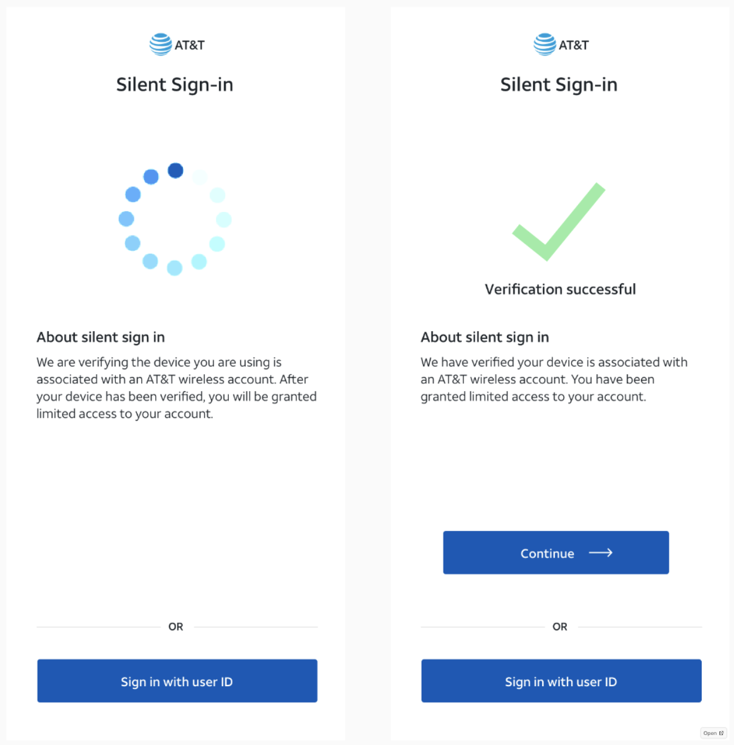
KEY findings
Challenges of traditional login credentials: participants expressed frustration with passwords due to forgetfulness, security concerns, and the cumbersome nature of password management.
Desire for enhanced security: users emphasized the importance of robust security measures in secure transactions, highlighting the need for additional authentication layers.
Preference for streamlined authentication: participants favored authentication methods that offered a balance between security and convenience, seeking frictionless user experiences.

Slide 8
recommendations
Usability optimization: streamline the authentication process and provide clear guidance during MFA enrollment and usage to mitigate usability challenges.
Security enhancement: implement robust security measures, such as silent network authentication and multi-factor authentication (MFA), to safeguard sensitive transactional data.
User education: launch initiatives to educate users on the benefits of alternative authentication methods and raise awareness about security best practices.
Continuous improvement: continuously monitor user feedback and iteratively refine the authentication process based on evolving user preferences and security standards.

Slide 9




Long-term strategic vision
Future CX
Passive, continuous authentication with risks-based AI/ML intervention
Behavioral biometrics
Password-less device & network auth
Physical biometrics
Risk-based auth Data Intelligence Behavioral Biometrics
Physical Biometrics
Current CX
Authentication using passwords, secret answers
Eliminate passwords that cause customer friction
Fast follow silent-network authentication with physical biometrics & behavioral biometrics
Notes:
Sameena
CX Strategy + Content Strategy: Psychographic, Playbook, audiences that matter (content creation), etc.

Slide 10
APPENDIX

Slide 11
Research Brief for User Interviews
Objective: the objective of the user interviews is to gather qualitative insights into participants' authentication preferences, security concerns, and transactional behaviors, particularly in the context of secure transactions such as bill payments. The interviews aim to explore the challenges associated with traditional login credentials and users' openness to alternative authentication mechanisms, including silent network authentication and multi-factor authentication (MFA).
Participant profile:
Age: 18-65 years
Demographics: diverse backgrounds (gender, ethnicity, occupation)
Technology proficiency: varied levels (from novice to expert)
Usage patterns: regular users of online payment platforms for bill payments

Slide 12
Interview structure
Introduction (5 minutes):
Introduce the interviewer and establish rapport with the participant.
Provide an overview of the interview objectives and the importance of their participation.
Authentication preferences (15 minutes):
Explore participants' current authentication methods for online transactions, including bill payments.
Inquire about their experiences with traditional login credentials (username/password) and any associated challenges or frustrations.
Probe participants' attitudes towards alternative authentication mechanisms, such as silent network authentication and multi-factor authentication (MFA).
Security concerns (10 minutes):
Discuss participants' perceptions of security in online transactions, specifically in the context of bill payments.
Investigate any security-related incidents or concerns they have encountered in the past.
Gauge participants' willingness to adopt additional security measures, such as MFA, to enhance the security of their transactions.
Transactional behaviors (15 minutes):
Explore participants' typical transactional habits when paying bills online.
Inquire about the devices and networks they use for online transactions and any contextual factors that influence their authentication preferences.
Discuss the importance of security and convenience in their transactional experiences.
Closing and thank you (5 minutes):
Summarize key points discussed during the interview.
Thank the participant for their time and valuable insights.
Provide contact information for any follow-up questions or clarifications.

Slide 13
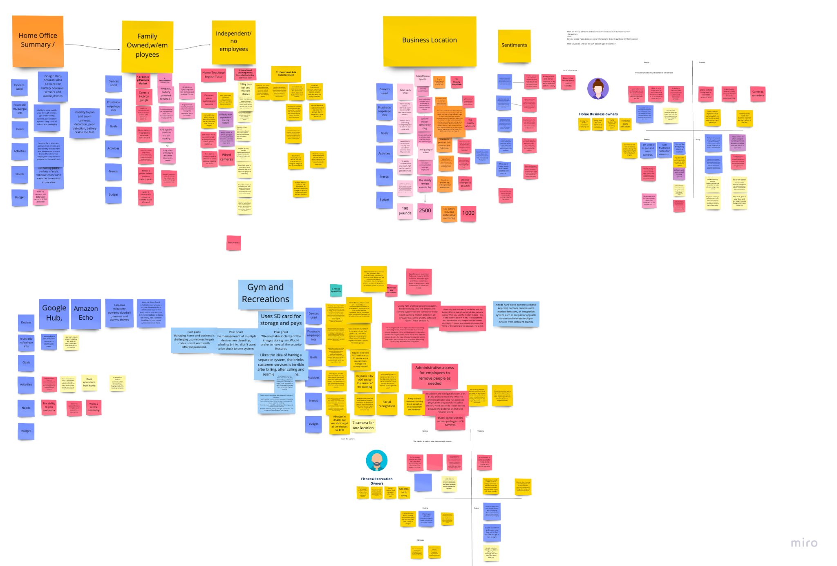
DATA Analysis & Synthesis
Data cleaning & preparation: ensure data quality and integrity through cleaning and transformation.
Exploratory data analysis (EDA): identify initial patterns, trends, and outliers visually and statistically.
Hypothesis testing & modeling: formulate hypotheses and develop models to test relationships and make predictions.
Interpretation & synthesis: interpret findings, draw conclusions, and generate insights for informed decision-making.

Slide 14
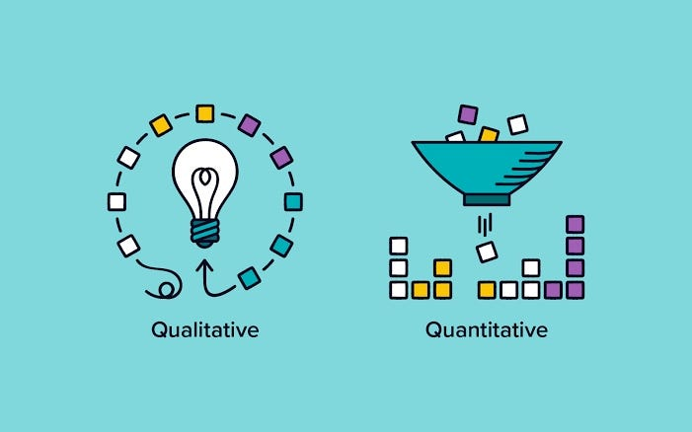
Data Analysis
Qualitative data analysis
Transcribed and coded qualitative data from user interviews, contextual inquiries, and prototype testing sessions.
Identified recurring themes, patterns, and insights related to user authentication preferences, security concerns, and transactional behaviors.
Conducted thematic analysis to derive meaningful interpretations and insights from the qualitative data.
Quantitative data analysis
Collated and analyzed survey responses to gather quantitative insights into user preferences, satisfaction levels, and security perceptions regarding authentication methods.
Generated summary statistics and visualizations to present key findings and facilitate data-driven decision-making.

Slide 15

Data Synthesis
Synthesis of findings:
Integrated qualitative and quantitative findings to develop a comprehensive understanding of user perspectives, security requirements, and usability considerations.
Identified commonalities and discrepancies across different data sources to triangulate findings and enhance the reliability of conclusions.
Synthesized key insights into actionable recommendations for optimizing authentication processes, enhancing security measures, and improving user experience in secure transactions.
Iterative refinement:
Engaged in iterative refinement of the analysis process, revisiting data sources and refining interpretations based on emerging insights and feedback.
Incorporated stakeholder input and expert perspectives to validate findings and ensure alignment with organizational goals and priorities.
Documented the analysis process and rationale behind key findings to maintain transparency and facilitate future research and decision-making processes.

